Slide 1
G-SUITE METRICS CSC 505/605 Fall 2019
By: Advisor :
Lavanya Goluguri Dr. Somya Mohanty
Anusha Vanama Mentor:
Jackie Cuong Nick Young Henry Reichard
Hieu Vo

Slide 2
Gmail Machine Learning
Goals: apply machine learning, specifically time series analysis to Gmail Data.
Five attributes specifically picked by our mentor:
num_emails_received, num_emails_sent, num_inbound_rejected_emails, num_inbound_spam_emails, num_inbound_non_spam_emails
Other attributes of interest:
1day_active_users, num_emails_exchanged, inbound_delivered_emails, outbound_rejected_emails

Slide 3
Gmail Task
The Question:
Can I predict the data for 2020 based on my current available data and how accurate would be the predictions will be?
After getting accurate predictions, can I fill 0s or missing days in my dataset?
Why was the question asked?
To achieve the overall project goal of detecting anomalies and give the ITS department a firm understanding what is happening with Gmail throughout the year and allow the ITS department to prepare in advance to seasonal and overall trends.

Slide 4
Progress made towards the task
Method Used to Answer the Question:
Time series analysis using Facebook Prophet.
Facebook Prophet is a procedure for forecasting time series data based on an additive or multiplicative model where non-linear trends are fit with yearly, weekly, and daily seasonality, plus holiday effects. It works best with time series that have strong seasonal effects.
What was done to solve for the question?
Written a function that sent the time column and the attribute to the fb prophet function. The function returns a cross validation head and tail, and a plot of the prediction and the datapoints. Some predictions had negative values and I went ahead and replaced negative values with 0. I filled 0s and missing days in the dataset with the mentor picked attributes with predicted values

Slide 5
Description of the results/outcomes
What were the outcomes
For good majority of the attributes, I got a very good prediction where MAPE is close to 0 or around 20% at the end of the prediction period (365 days). Inbound_non_spam_emails has decent prediction of around 16% around 40 days into the future and 44% at the end of the prediction.
Two anomalies where found, which are inbound_non_spam_emails and inbound_rejected_emails. Inbound_non_spam_emails have huge spikes in the first half of the dataset and both attributes had a major drop off and stagnation.

Slide 6
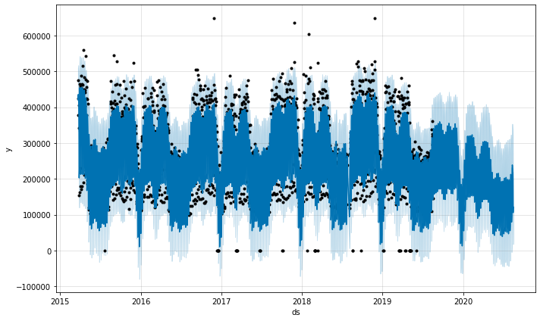
Num_emails_received

Slide 7
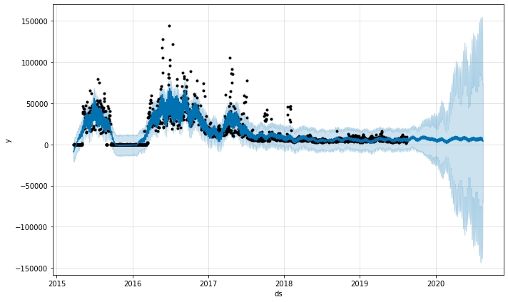
Inbound_rejected_emails

Slide 8
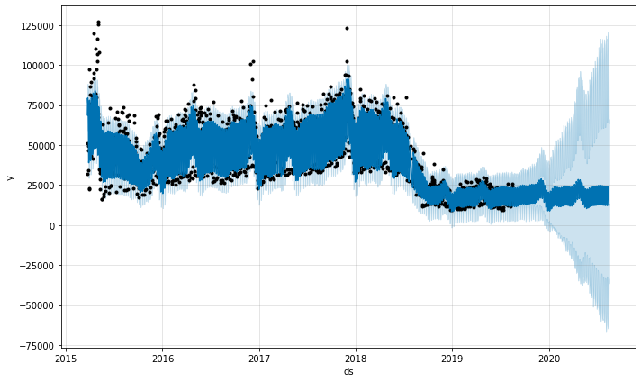
Inbound_spam_emails

Slide 9
Implications
The decent predictions will give the ITS department a firm understanding what is happening with Gmail throughout the year and allow the ITS department to prepare in advance to seasonal and overall trends in Gmail. The big question is why these services are not growing proportional to the growth of UNCG?
1) Students don't send emails as much as they used to 5 years ago.
2) People are using chat more than email now.
3) Google is doing a better job of blocking spam from being received in the first place.
4) Active users however are expected to see similar growth in relation to the overall population. Its possible students/users aren't using their accounts as much as they used to.

Slide 10
Implications Continued
The anomalies found in inbound_rejected_emails and inbound_spam_emails can be explained by multiple of reasons. Before Nick (The mentor) joined the ITS Department, the ITS department used to be only reactive too attacks or spam. Over the years the ITS department took the "best defense is the best offense" approach by being more proactive. Additionally it is likely Google is doing a better job of handling rejections than they were before. IE : better at spam and phishing prevention. These reasons explains why there is a huge drop off in these attributes. The implication here is that there is progress being made to limit spam or hazardous emails and that is a good thing.

Slide 11
Establishment of Machine Learning goals
GOOGLE DRIVE:
My Main goal is to perform predictions on Drive data.
The Machine learning model I used to achieve this is Time Series Analysis using Fb Prophet.
I have used the same metrics on which I performed the statistical analysis.

Slide 12
METRICS USED
30day_active_users 1day_active_users
Google_forms_created Google_forms_edited
Google_documents_created Google_documents_edited

Slide 13
TASK BY MEMBER
My Question on this data is mainly can I predict the future data based on current data values.
Why was the question asked?
As the data is time series data, I did the time series analysis to predict the future values, and tested the accuracies using cross validation and mse(Mean squared error), mape(Mean absolute percentage error) measures.

Slide 14
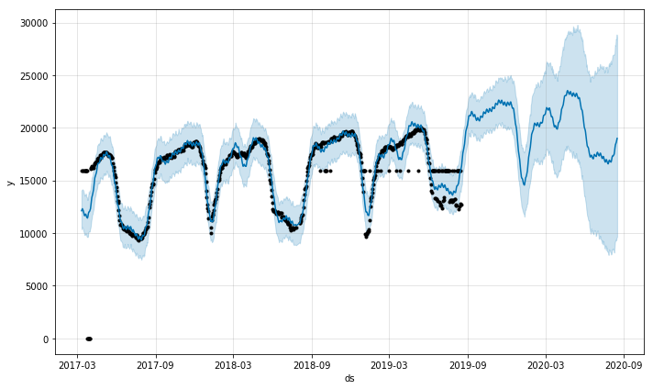
Progress made towards the task
TIME SERIES ANALYSIS USING FB PROPHET:
The time series analysis for 30day_active_users.

Slide 15
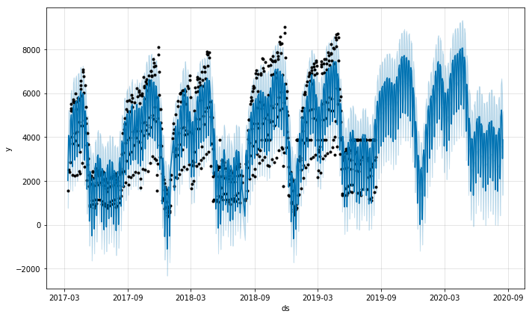
1day_active_user

Slide 16
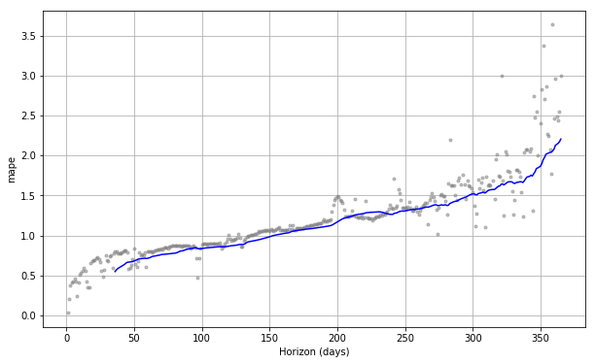
ERROR VALUES IN PREDICTION

Slide 17
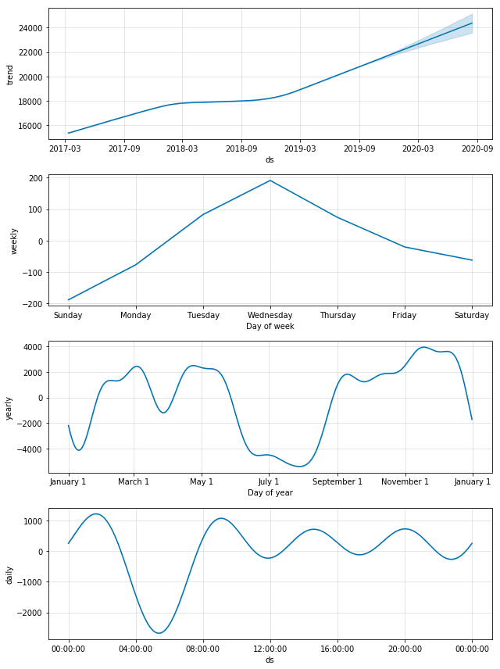
TRENDS IN DATA PREDICTION

Slide 18
Description of the results and Implications
From the time series analysis I was able to predict the data values for few attributes with minimum error .
The trends that are seen the current data are also seen in the future data like increase in usage in the semester end and almost no activity during semester breaks.
Predictions are more accurate in the initial days of forecast than in the later days.

Slide 19
G-Calendar Prediction
How can the data for Google Calendar be used to predict changes in the future

Slide 20
Progress made towards G-Calendar
Using FB Prophet to perform time series analysis
Allows the use of past data collected to predict the data trends for the future

Slide 21
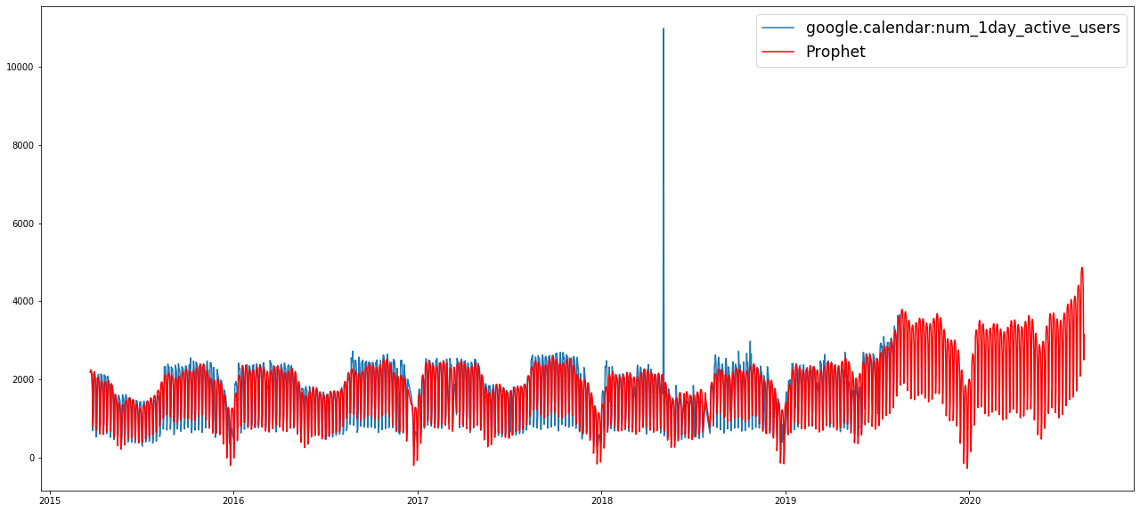
Description of the results/outcomes

Slide 22
Establishment of Dashboard goals
Generate graphs to dynamically visualize past data generated data predicted from machine learning

Slide 23
Dashboard task Jackie
How does the data look over time?
Why was the question asked?
Creating a visualization for data in the dashboard users can see outliers and target data in specific dates

Slide 24
Progress made towards the task
Dashboard implemented in Google Data Studio, and using graph generation feature implement line graphs
Added date filtering and data filtering to allow users to specifically set and see what data and when

Slide 25
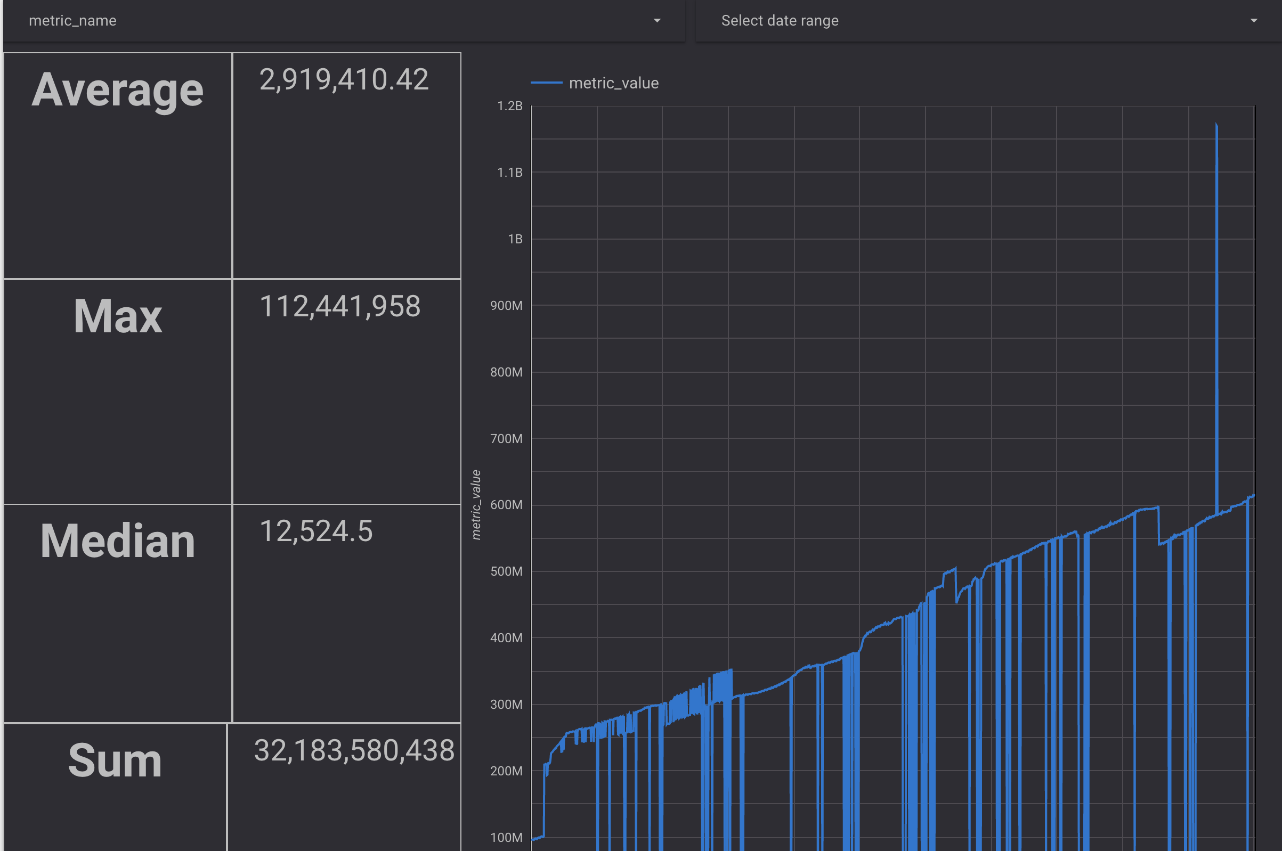
Description of the results/outcomes

Slide 26
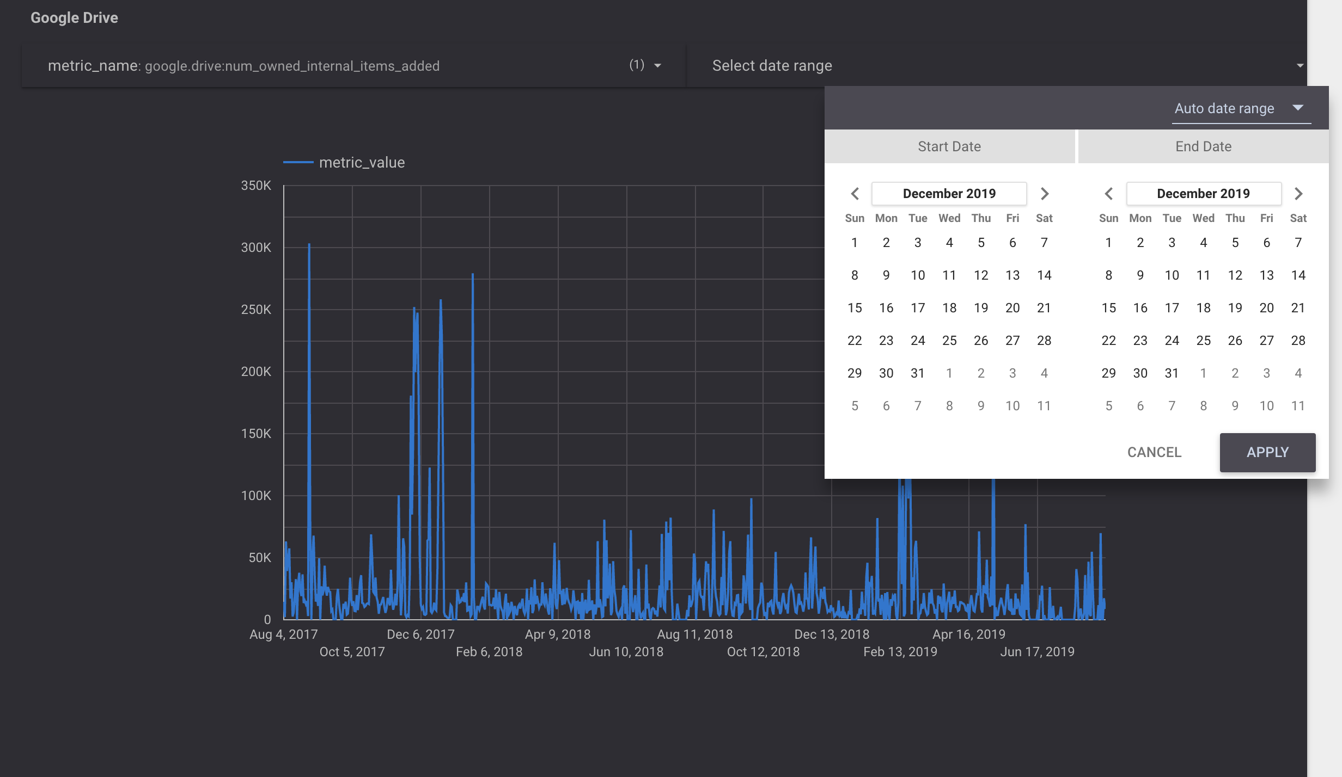
Results Cont.

Slide 27
Google Account
Question: how can I use the past data to predict what will happen in the next year?
Task:
Use machine learning to predict or forecast from past data
Visualization
Main attributes:
Google drive mb
Google gmail mb
Google gplus mb
Google 1, 7 and 30 day active user
Google total quota mb

Slide 28
Progress
Using fbprophet for forecasting time series data.
Using linear-regression machine learning to predict the amount of data use for each google service based on amount of users.
Visualization of data used from google Gmail, drive and gplus

Slide 29
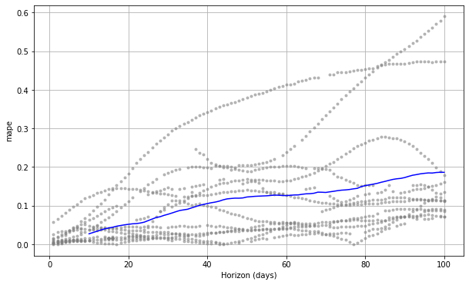
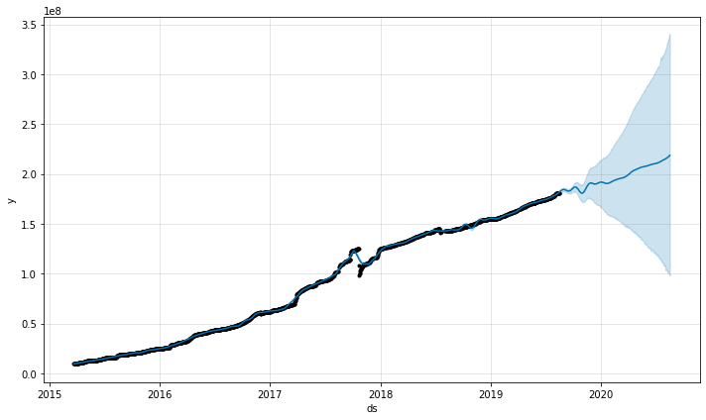
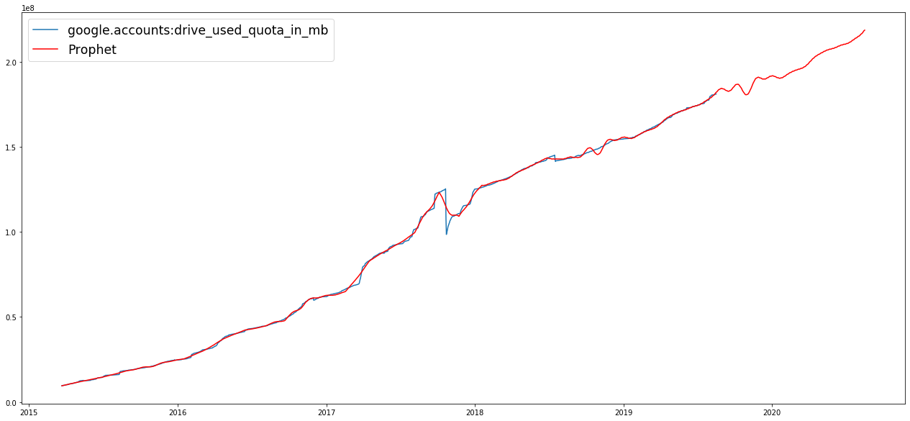
Fbprophet on data usage

Slide 30
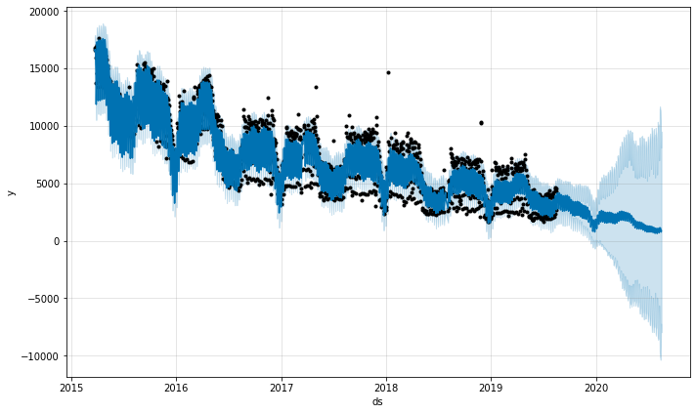
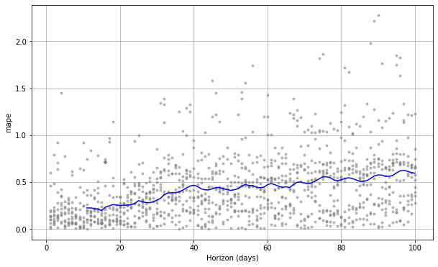
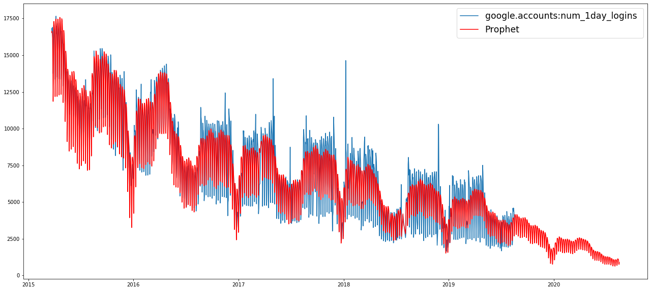
Fbprophet on active user

Slide 31
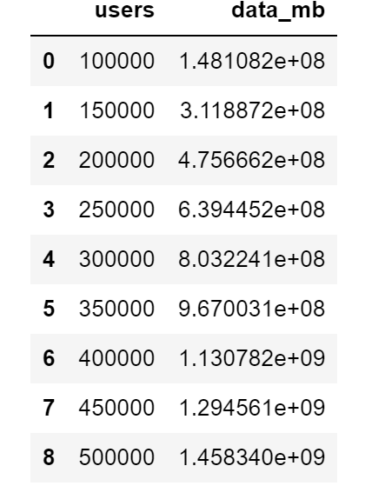
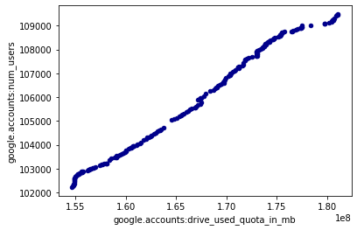
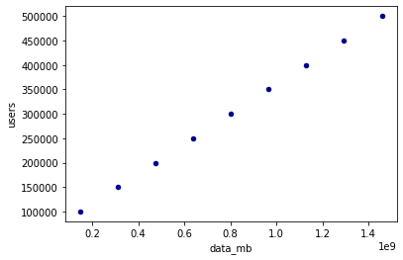
Linear-regression ML

Slide 32
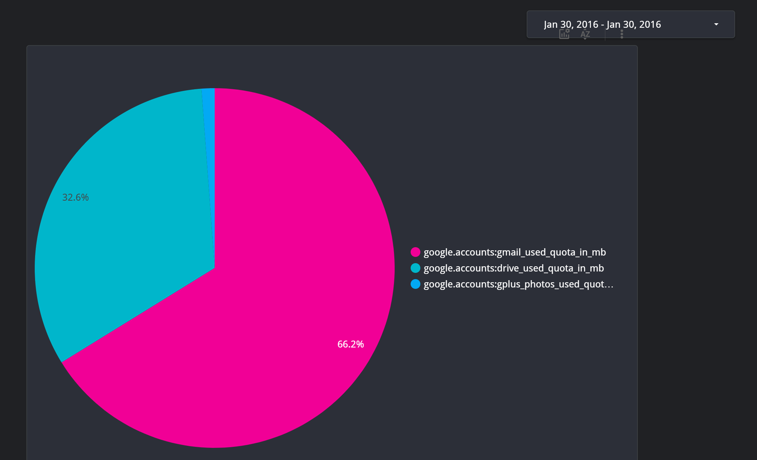
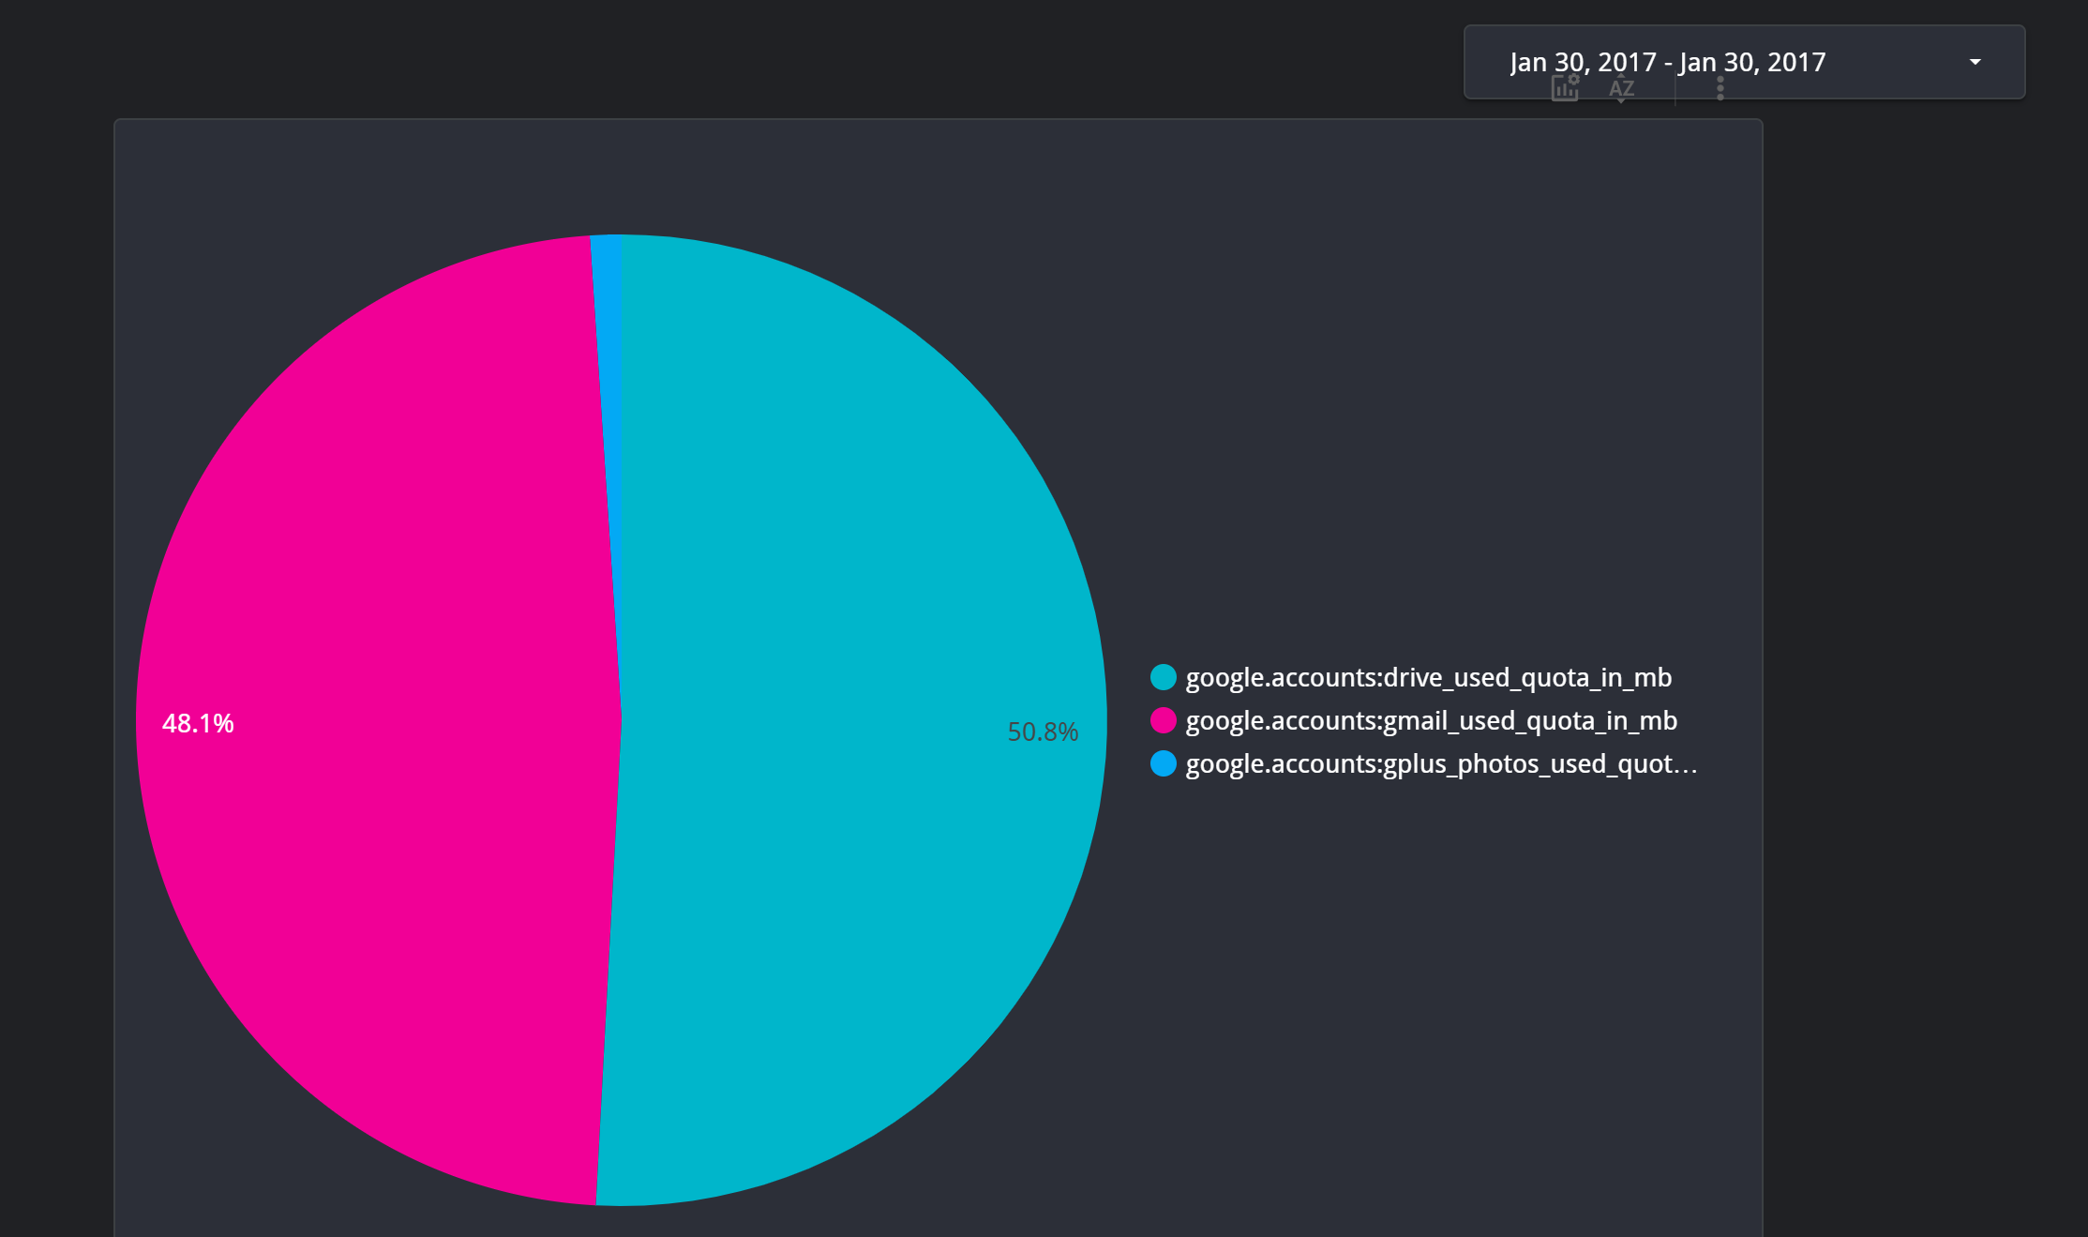
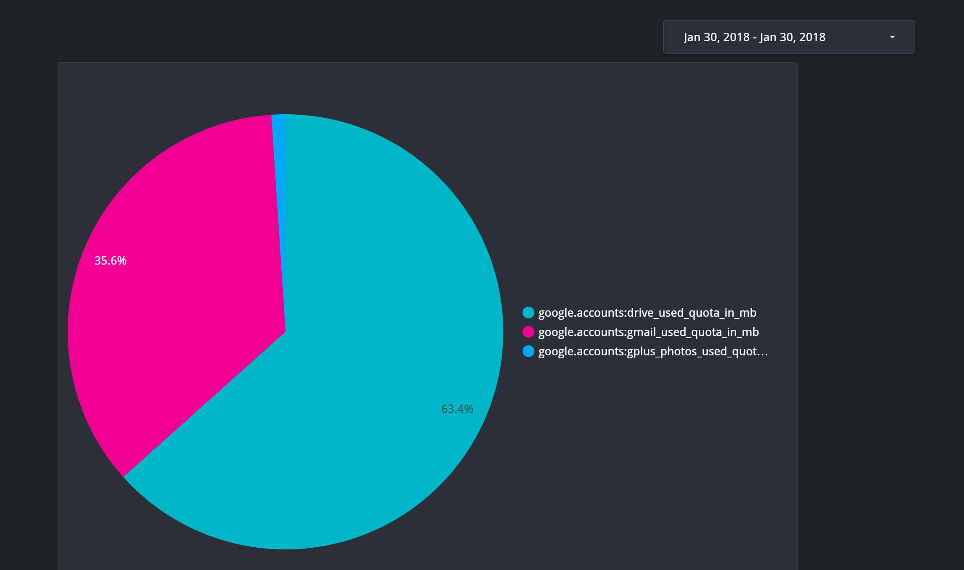


Slide 33
Result
Increasing in data usage.
Predict data usage base on number of users.
Predict active users.
Visualization help to tell the increasing or decreasing of data usage.

Slide 34
Establishment of Machine Learning goals
Prediction of future metric value based on the current data set values for top 6 metrics under Google Meet.
Time series forecasting is a technique for the prediction of events through a sequence of time.

Slide 35
TASK BY MEMBER
Question - Can we predict the metric values for next year based on the previous years data. How accurate will be our predictions?
Why was the question asked? - Our mentor is interested in finding the unexpected spikes, drops, trend changes and level shifts. It will allow them to prepare in advance for the next year.

Slide 36
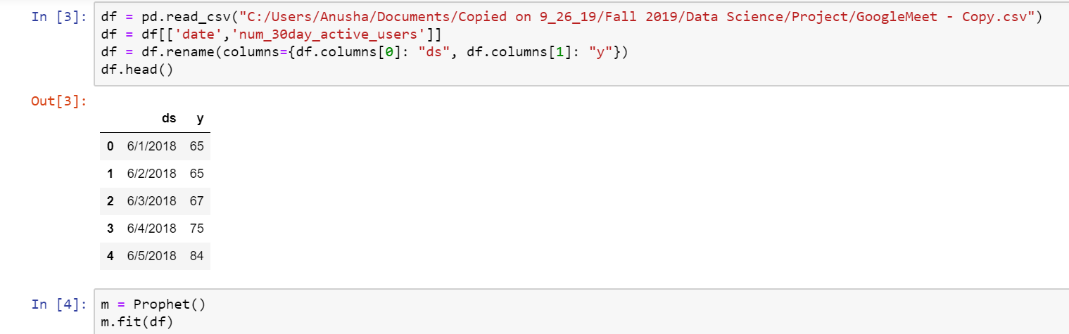
Progress made towards the task
Method used and What was done to solve for the question?
Facebook prophet is used to perform time series analysis on google meet metrics.
The input to Prophet is always a data frame with two columns: ds and y. The ds (datestamp) column and the y column represents the values of a metric we wish to forecast.
We fit the model by instantiating a new Prophet object.

Slide 37
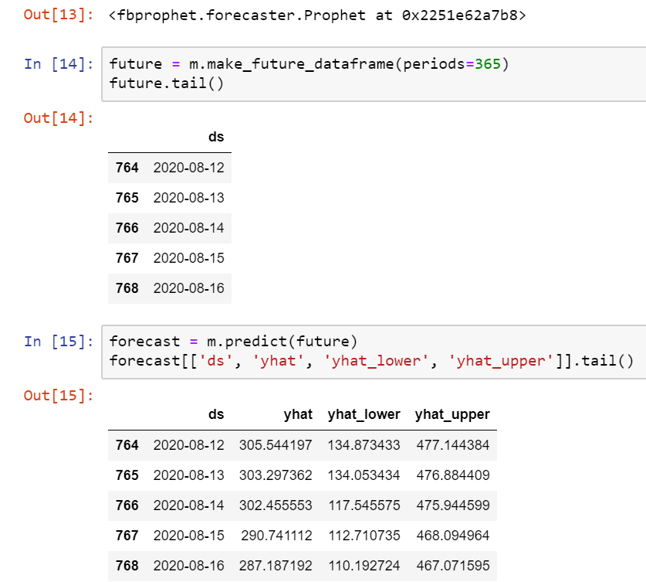
Progress made towards the task
Predictions are made for the future period of 365 days(1 Year).

Slide 38
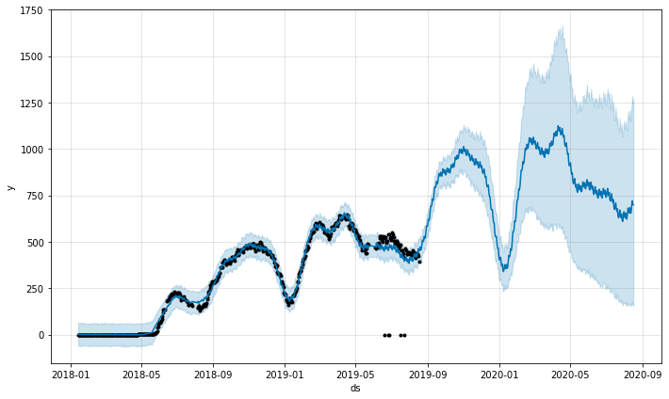
Outcomes/Implications
Time Series Analysis for Number of 30 day Active users in Google Meet

Slide 39
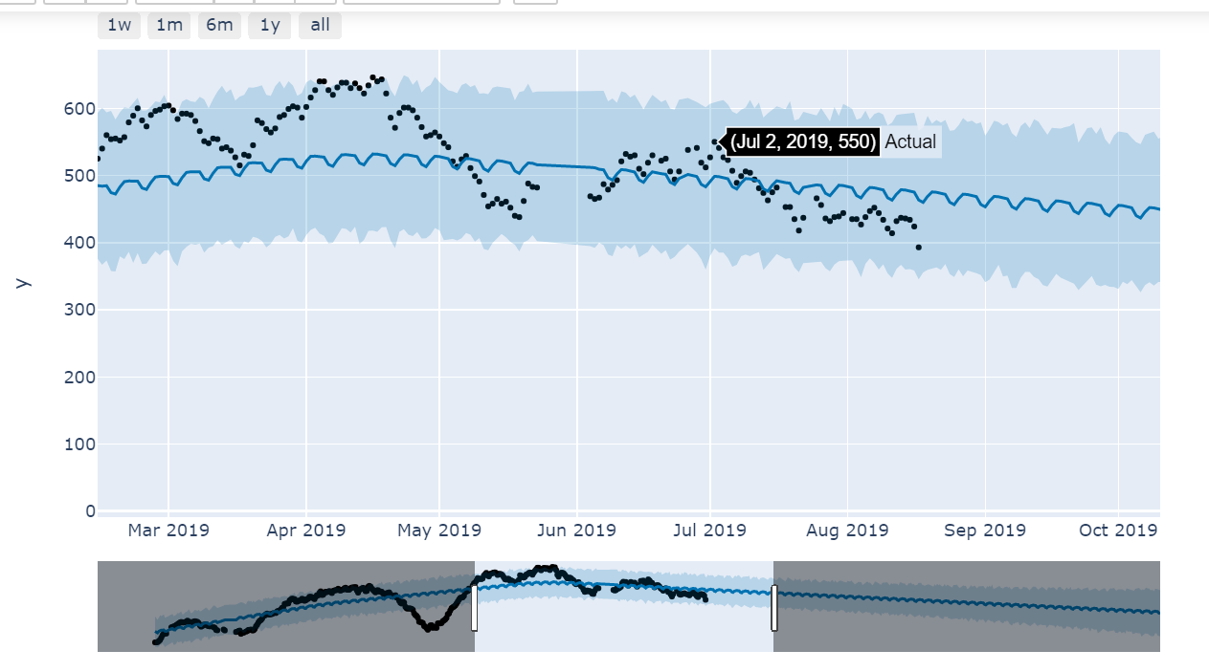
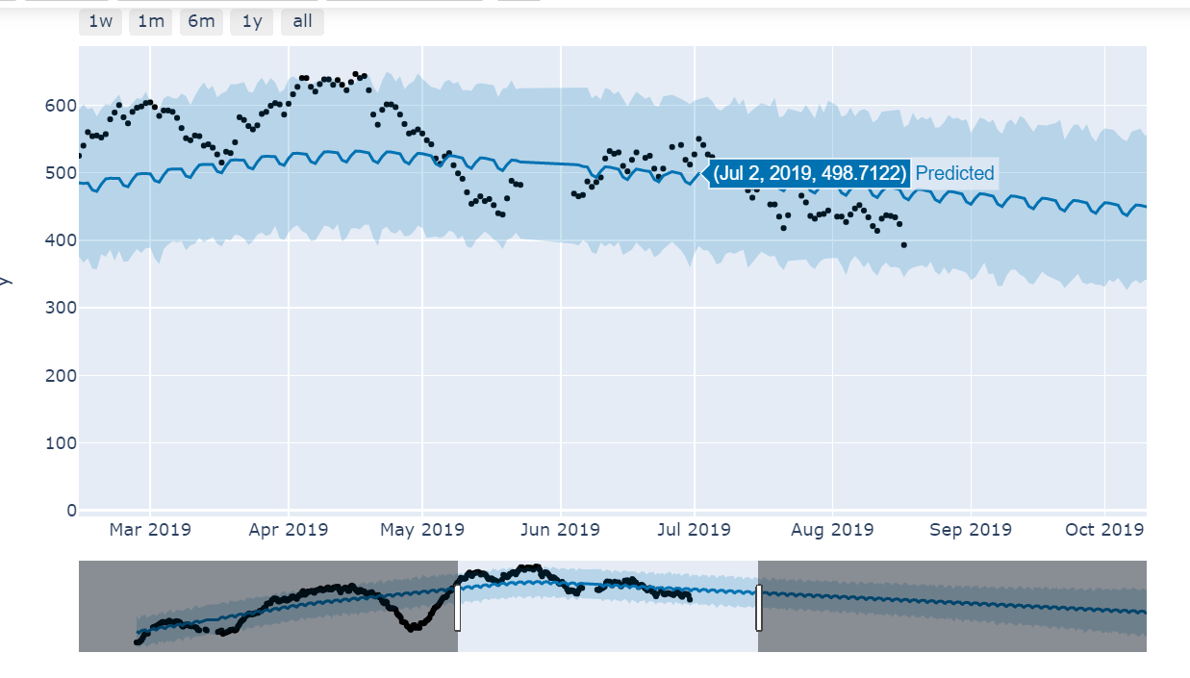
Outcomes/Implications
Actual and Predicted Values

Slide 40
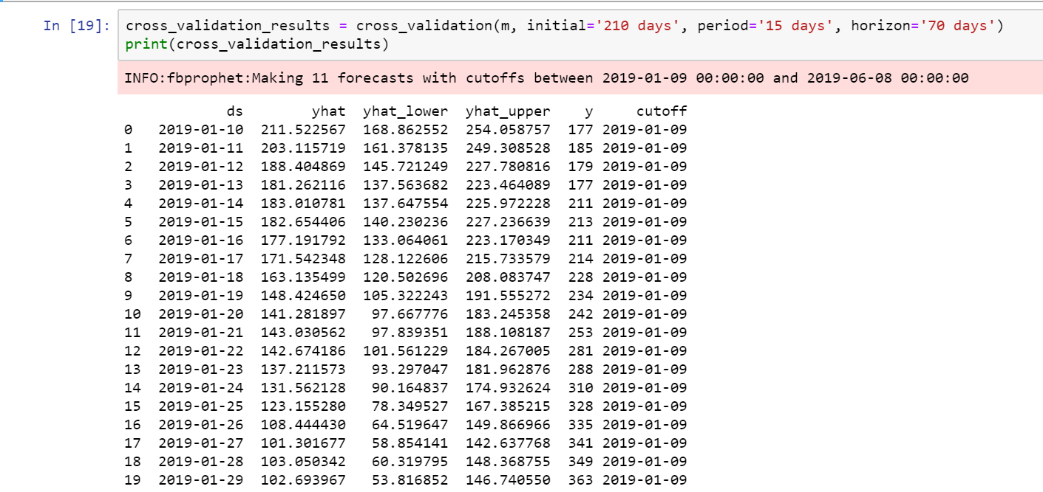
Outcomes/Implications
Cross validations are done to assess prediction performance on a horizon of 70 days, starting with 210 days of training data in the first cutoff and then making predictions every 15 days.

Slide 41
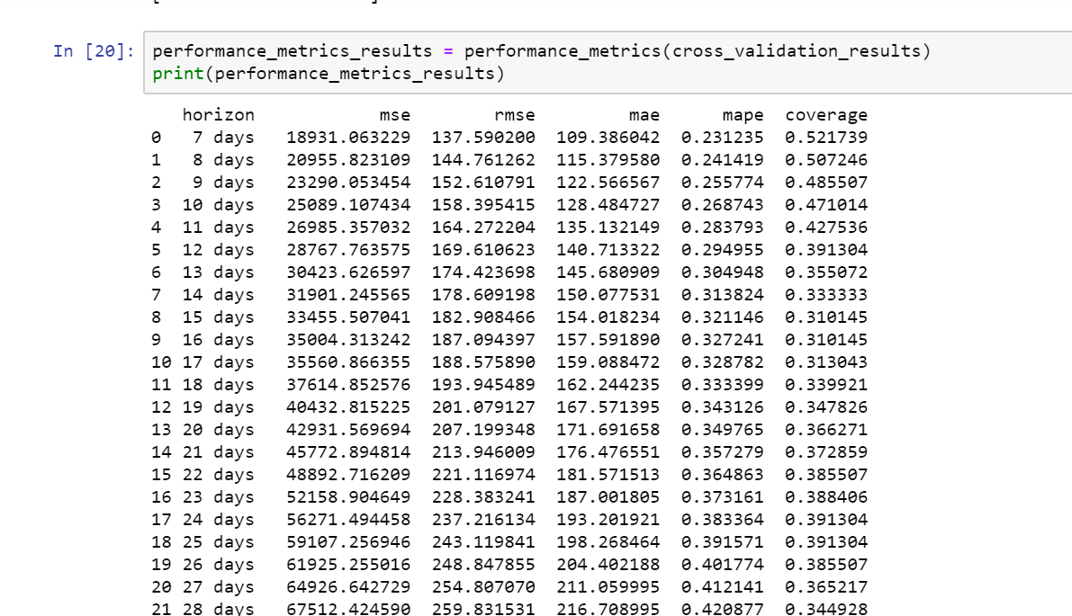
Outcomes/Implications
The mean absolute percentage error (MAPE) is a statistical measure of how accurate a forecast system is.

